Slide 1
Professional Practices
Chap # 11 &12

Slide 2
Categories of misuse
In their study of the English criminal law, the Law Commission 11 highlighted a number of categories of misuse of computers. These were:
(a) computer fraud;
(b) unauthorized obtaining of information from a computer, which they sub-categorized into the following:
• computer hacking;
• eavesdropping on a computer;
• making unauthorized use of computers for personal benefit;
(c) unauthorized alteration or destruction of information stored on a computer;
(d) denying access to an authorized user;
(e) the unauthorized removal of information stored on a computer.

Slide 3
Obtaining unauthorized access to a computer
The second form of misuse identified by the Law Commission was unauthorized obtaining of information from a computer. As already stated, they sub-divided this into three particular abuses:
• computer hacking;
• eavesdropping on a computer;
• making unauthorized use of computers for personal benefit.

Slide 4
Computer Misuse Act 1990
Under Section 1 of the 1990 Act, a person will be guilty of an offence if:
(a) he causes a computer to perform any function with intent to secure access to any program or data held in any computer;
(b) the access he intends to secure is unauthorized;
(c) he knows at the time when he causes the computer to perform the function that that is the case.
Notes:
Forgery : A person is guilty of forgery if he makes a false instrument, with the intention that he or another shall use it to induce somebody to accept it as genuine, and by reason of so accepting it, to do or not to do some act to his own or any other person’s detriment.
Eavesdropping : Eavesdropping involves secret listening or watching.

Slide 5
Convergence of data protection practices: the formulation of fair use guidelines
1. Information should be regarded as held for a specific purpose and should not be used without appropriate authorization for other purposes.
2. Access to information should be confined to those authorized to have it for the purpose for which it was supplied.
3. The amount of information collected and held should be the minimum necessary for achievement of a specified purpose.
4. In computerized systems handling information for statistical purposes, adequate provision should be made in their design and programs for separating identities from the rest of the data.
5. There should be arrangements whereby the subject could be told about the information held concerning him.
6. The level of security to be achieved by a system should be specified in advance by the user and should include precautions against the deliberate abuse or misuse of information.
7. A monitoring system should be provided to facilitate the detection of any violation of the security system.
8. In the design of information systems, periods should be specified beyond which the information should not be retained.
9. Data held should be accurate. There should be machinery for the correction of inaccuracy and the updating of information.
10. Care should be taken in coding value judgments.

Slide 6
The ingredients of defamation
Defamation is divided into libel and slander. The obvious distinction is that libel applies to written statements whereas slander is relevant to the spoken word.
defamatory statement was one “which is calculated to injure the reputation of another by exposing him to hatred, contempt or ridicule”.
The difference is not merely academic—libel is actionable per se whereas requires proof of damage for an action to succeed.
Finally, for a successful defamation action, the statement must have been published to at least one other person.

Slide 7
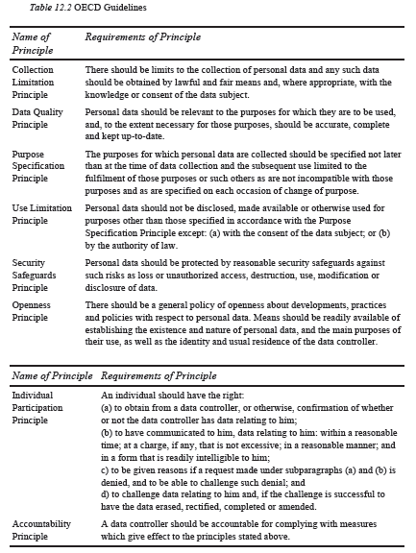
OECD Guidelines
Notes:
Page#286
Data Protection Act 1984,Data Protection Act 1998 (detail in book Chap#12)

Slide 8
Comparison of Health Hazard safety act pre-and post-1947 legislation
Table 9.1 (Page 206)

